Slide 1
Designing a bed‐side system
for predicting length of stay
in a neonatal intensive care unit

Slide 2
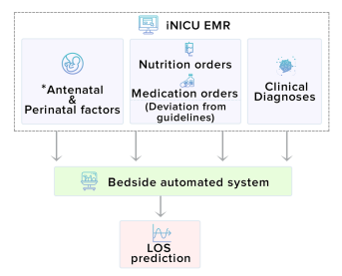
Overview
Increased length of stay (LOS) in hospital critical care units (CCU) has been associated with adverse events, increased costs, and increased risks of mortality
By accurately predicting the LOS we can better account for those risk factors.

Slide 3
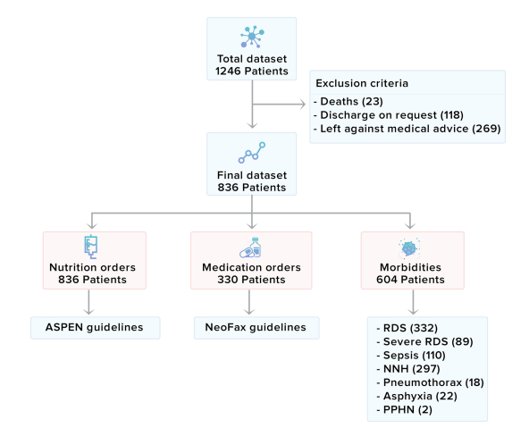
Data Collection
Te data extraction process extracted the information for each patient from the database and aggregated the same with assessment, medication, and nutrition entries. Tis step was performed in Java, and it generated a CSV file as an output. Te missing data during the study was handled using a four-way approach. (1) System validations: the platform ensured mandatory data entry validations for perinatal and antenatal data such as gestation, APGAR, maternal risk factors, were enforced and notifications were sent to staff in case of missing data. Te platform also implemented the medication guideline for the drugs present in the NeoFax system to recommend the correct dosage and frequency of the prescribed medications. (2) Review meetings: regular review meetings with departmental staff ensured the completeness and quality of the entered data in the iNICU platform. (3) Forward filing data: the missing nutrition orders were forward filled from previous order till the next order, there was no change in prescribed enteral or parenteral volume, (4) Imputation strategies: some data for out-patients were still missing during the data analysis process which was handled by data imputation strategy of filing with population mean. Any feld containing more than 10% imputed data was not considered for the LOS prediction model.

Slide 4
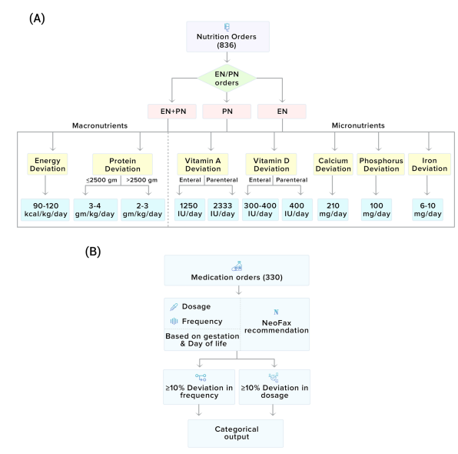
Risk factors for LOS.
Clinical diagnosis data included information on most frequent cases recorded in NICUs are: (a) hyperbilirubinemia requiring phototherapy, (b) sepsis, (c) respiratory distress including subcategories respiratory distress syndrome, severe respiratory (mechanical ventilation and or surfactant administration), persistent pulmonary hypertension of the newborn (PPHN), pneumothorax, and (d) birth asphyxia.
2.EN/PN orders
3. Medical orders

Slide 5
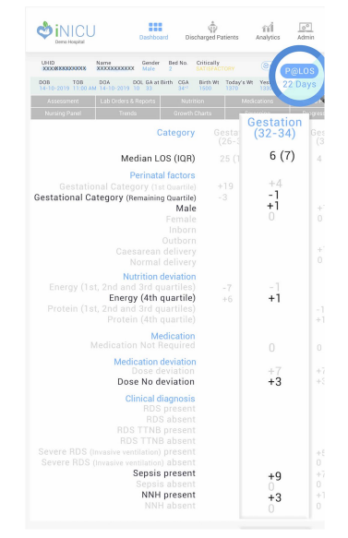
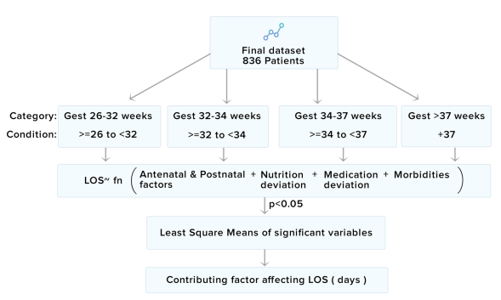
Results

